Slide 1
LLM Factorization
Using Addition and multiplication Only

Slide 2
7th and 11th Branch Numbers are Prime numbers and composite Primes and perfect Nth powers
7th Branch Numbers |  | 11th Branch Numbers
1 | 1+10 = | 11
7 | 7+10 = | 17
13 | 13+10 = | 23
19 | 19+10 = | 29
25 | 25+10 = | 35
31 | 31+10 = | 41
37 | 37+10 = | 47
43 | 43+10 = | 53
49 | 49+10 = | 59
55 | 55+10 = | 65
61 | 61+10 = | 71
67 | 67+10 = | 77
73 | 73+10 = | 83
79 | 79+10 = | 89
85 | 85+10 = | 95
… |  | ….

Slide 3
LLM Factorization algorithm
Generate primary list for Prime numbers and its composites using only natural number (1, 4, 6) and operations (+ , *)
Using files in this algorithm gave us the ability to do Factorization in batches
Final prime number files can be generated from the factor files using simple filter condition (count of “;”)
The algorithm can be executed based on Start and End conditions for an execution range.
The algorithm execution time is liner based only on the batch size which is based on number of digits in the numbers and not based on any operations complexity.
The algorithm not only calculating the factors between two ranges but also getting the unique prime numbers in between this range
The algorithm can be executed using none consequence ranges or factors. Ex.[7,11,53,101]
The algorithm include statistical output log categorized by each factor and each batch file.
Algorithm execution time includes getting the full factorization for all numbers between Start and End condition and including an statistical execution run log and final prime number list and final statistical log output.
All Nth Prime files are not changed only 7th Prime files will have the factors.

Slide 4
11th Branch Numbers
6
4
1
ith Batch
File
N;X;N*X
*
+
+
No
Ends with 5
Jth Iteration
7th Branch Numbers
6
*
+
Batches
ith Batch
Jth Iteration
Batch Size
*
ith Batch File Primes From
Loop Range (From, To)
+
ith Batch File Primes To
Generate Initial Prime main List
7;X;7*X

Slide 5
11th Branch Numbers
6
4
N
ith Batch
File
N;X;N*X
*
+
+
No
Ends with 5
Jth Iteration
7th Branch Numbers
6
*
+
Batches
ith Batch
Jth Iteration
Batch Size
*
ith Batch File Primes From
Loop Range (From, To)
+
ith Batch File Primes To
Generate batch File for N
N;X;N*X

Slide 6
Create Batch Files
For Nth Factor
7 batch 0
7 batch 1
7 batch 2
7 batch N
Feedback
11 batch 0
11 batch 1
11 batch 2
11 batch N
13 batch 1
13 batch 2
13 batch N
‘;’ count > 2
13 batch 0
NO
Forward
Nth Item batch 0
Nth Item batch 1
Nth Item batch 2
Nth Item batch N
Feedback
Start From ith Line Fact
N Batches
YES
Generate Initial 7 main List
7;X;7*X
Prime List
File
Seek
Nth Fact
Factor by List
Batch Size
Stop at Nth Line Fact

Slide 7
Read ith Batch File for Nth Factor
Read ith Batch File for 7th Factor
Read line
N;X;N*X
7;M;7*M
Replace each
[;N*X;] by [;X;N;]
In 7th Factors File
If M = N *X will be Replaced by
7;N;X;7*M
EOF
Feedback from Nth Files Into 7th files

Slide 8
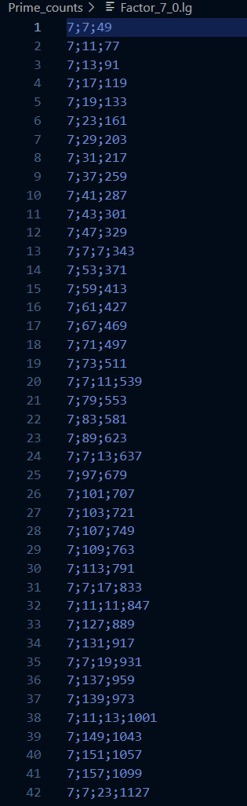
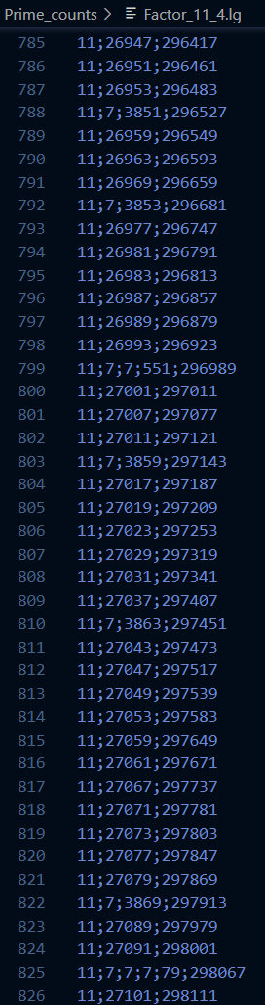
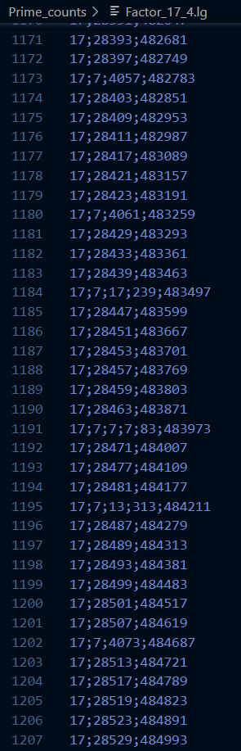
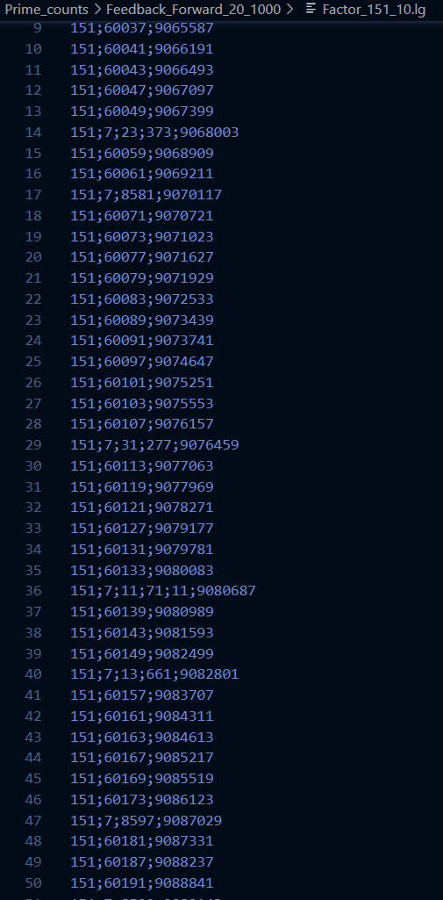
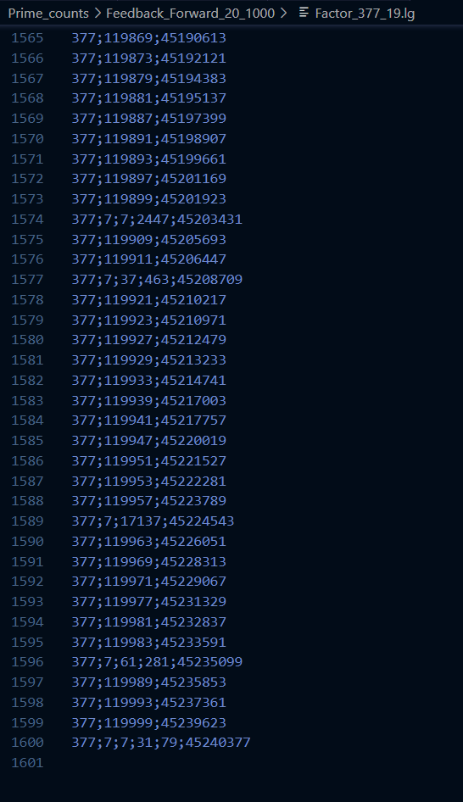
A;B;C;D;E = A*B*C*D = E

Slide 9

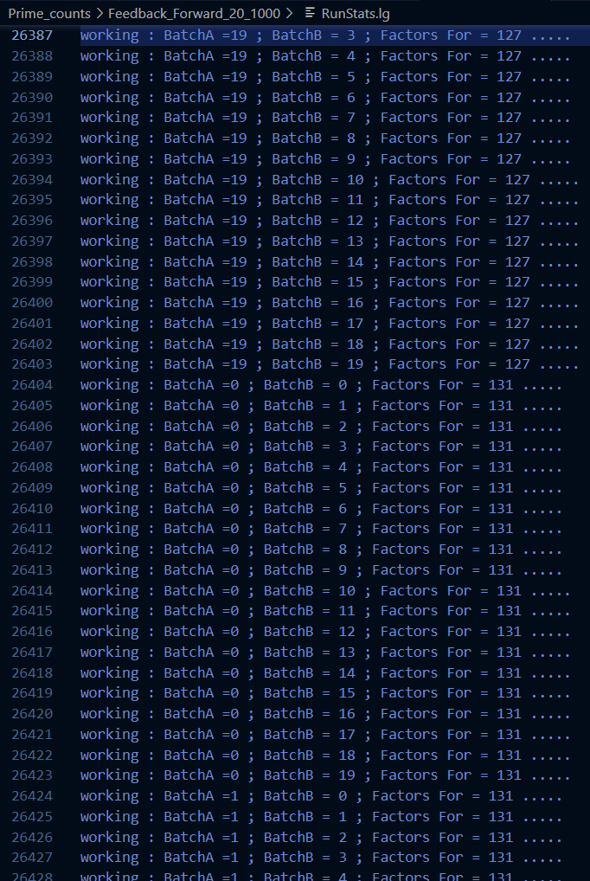
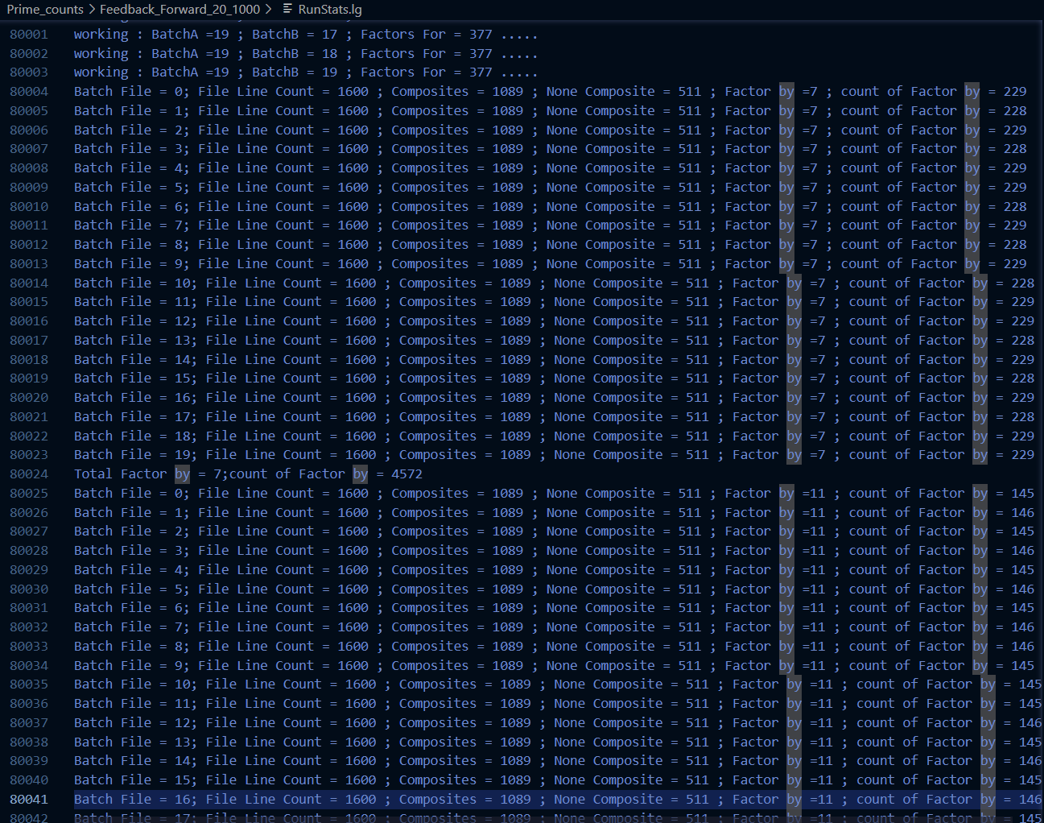

Slide 10
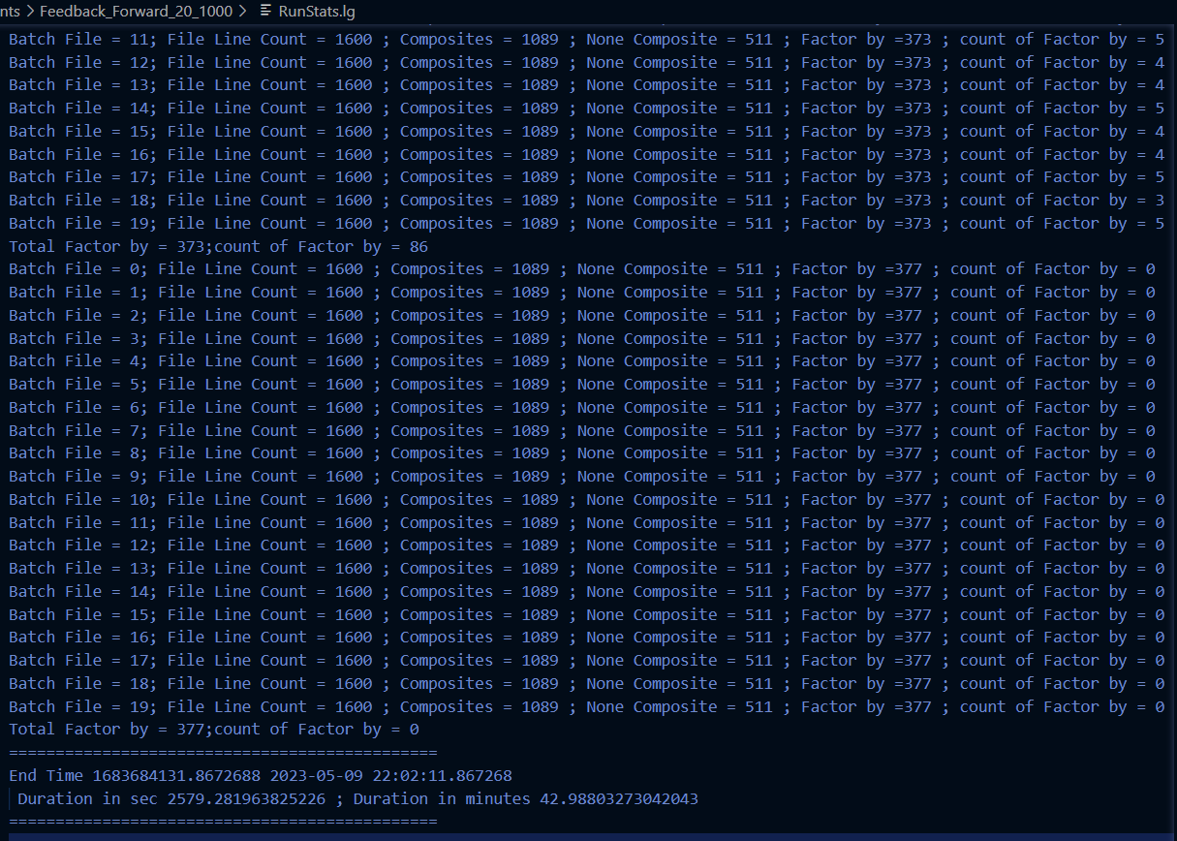
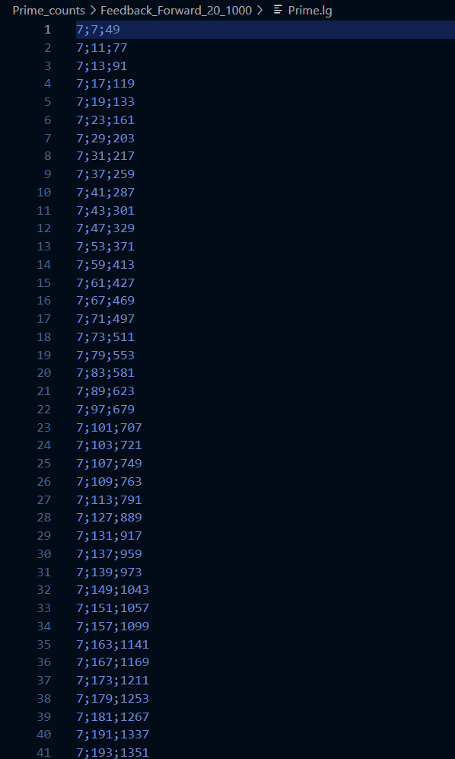
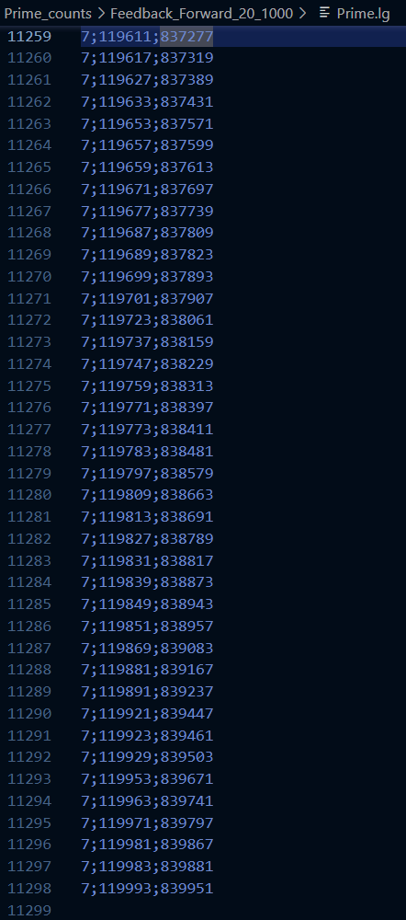

Slide 11
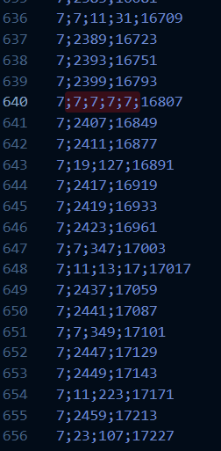
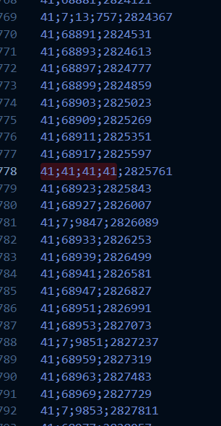
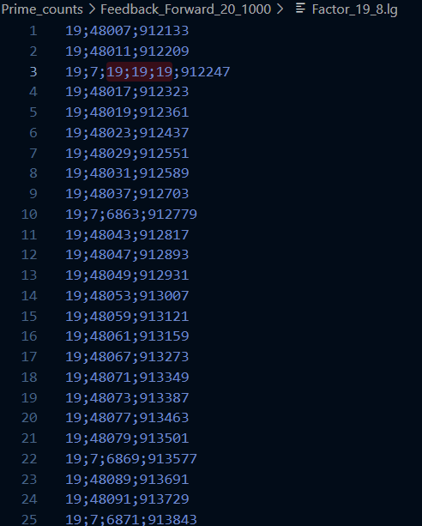
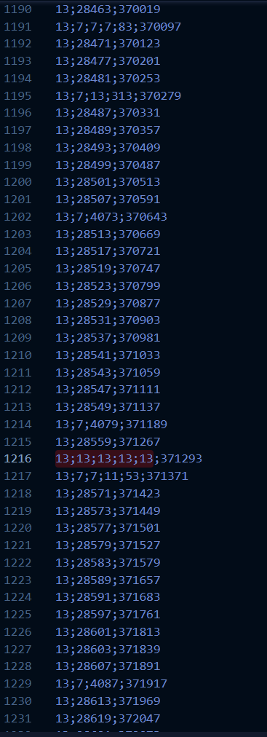
Factors for powers forward and backwards without any division

Slide 12
